Slide 1

MotorBeat: Acoustic Communication for Home Appliances
via Variable Pulse Width Modulation
Weiguo Wang ¹, Jinming Li ¹, Yuan He ¹, Xiuzhen Guo ¹, Yunhao Liu ¹
¹ Tsinghua University
Notes:
Hi, everyone;
I am Weiguo wang, from Tsinghua univ.
I am very happy to introduce our recent work, MotorBeat.

Slide 2
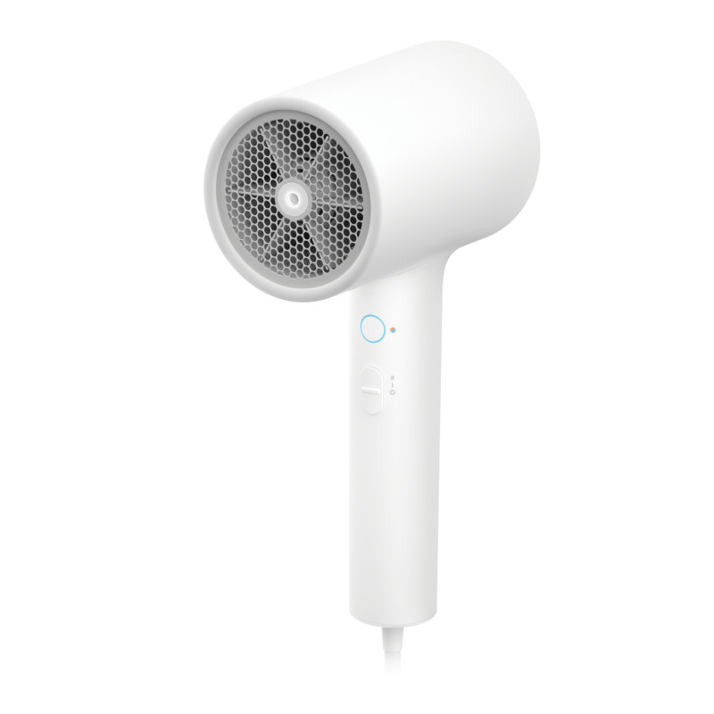
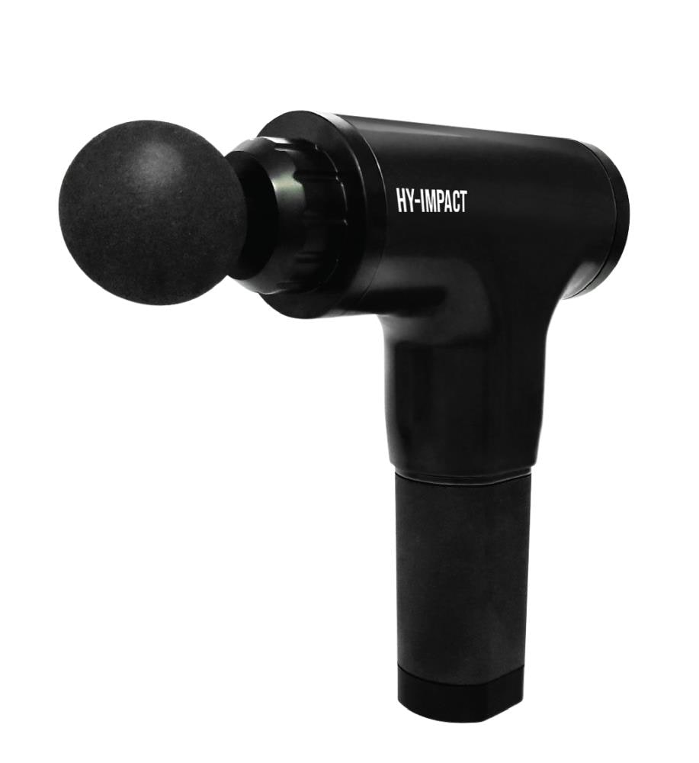
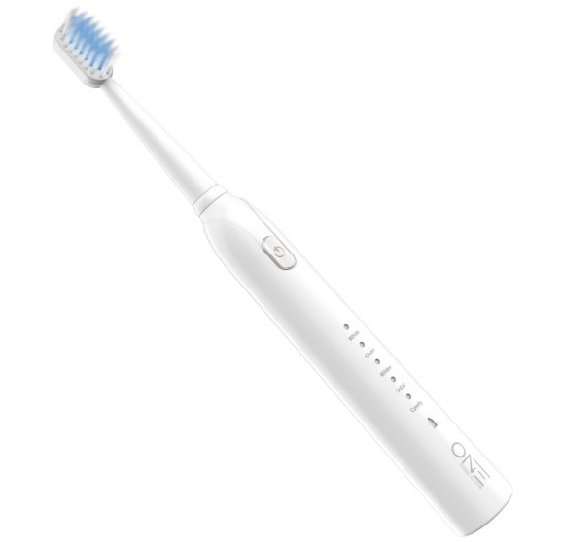
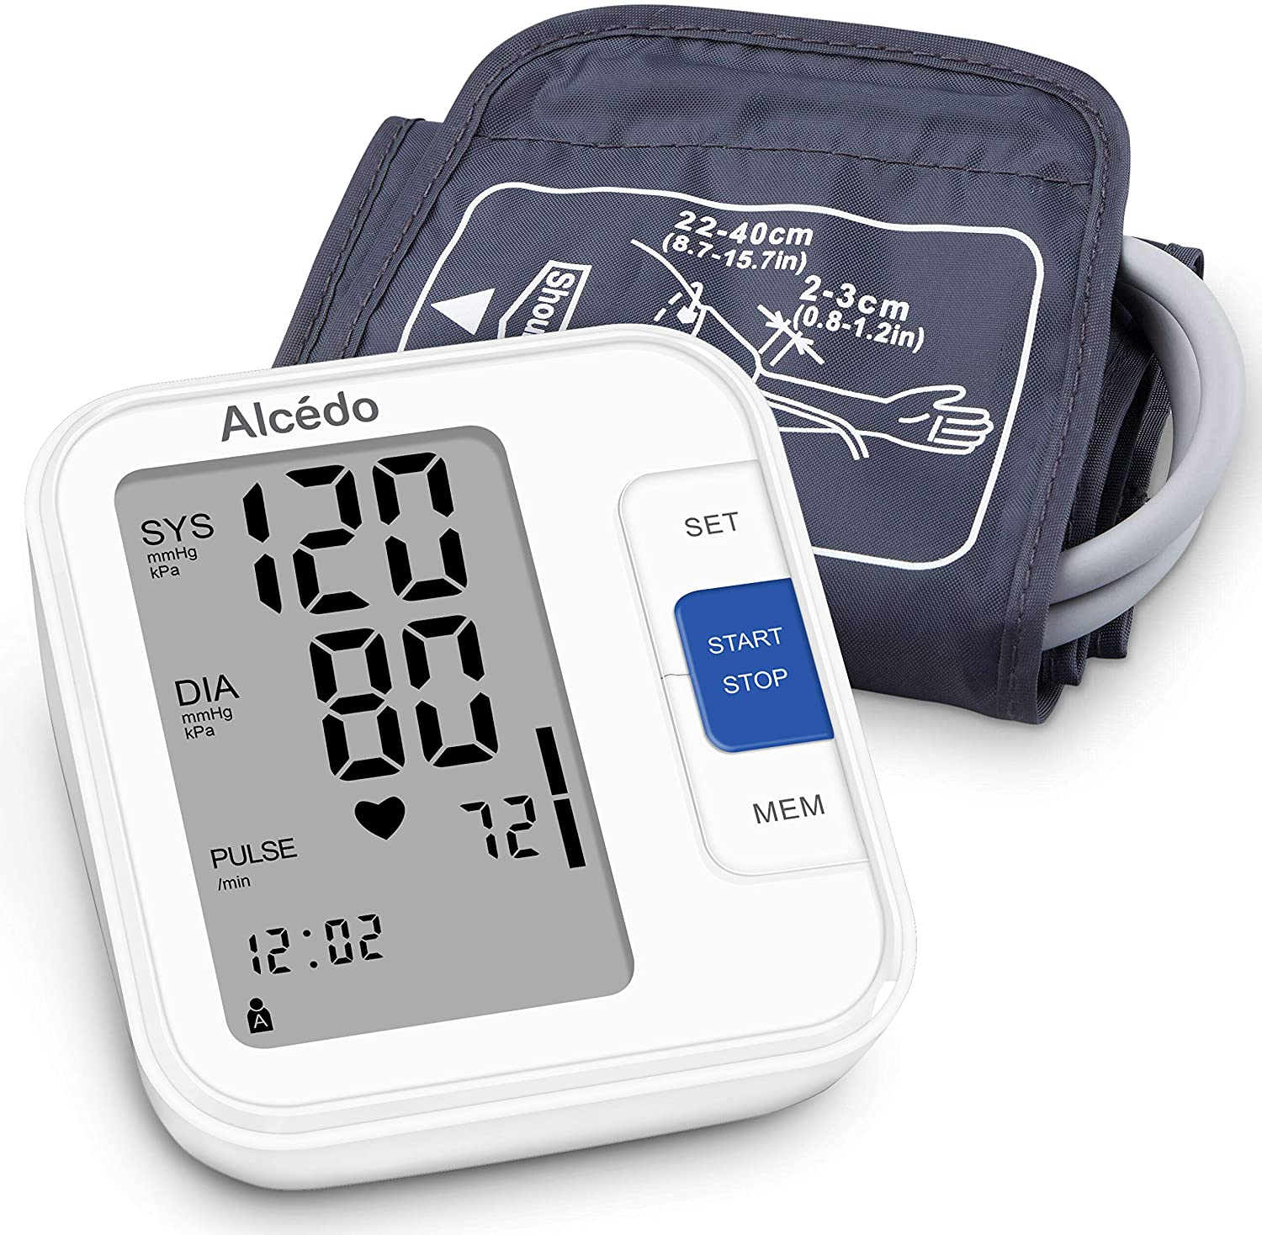
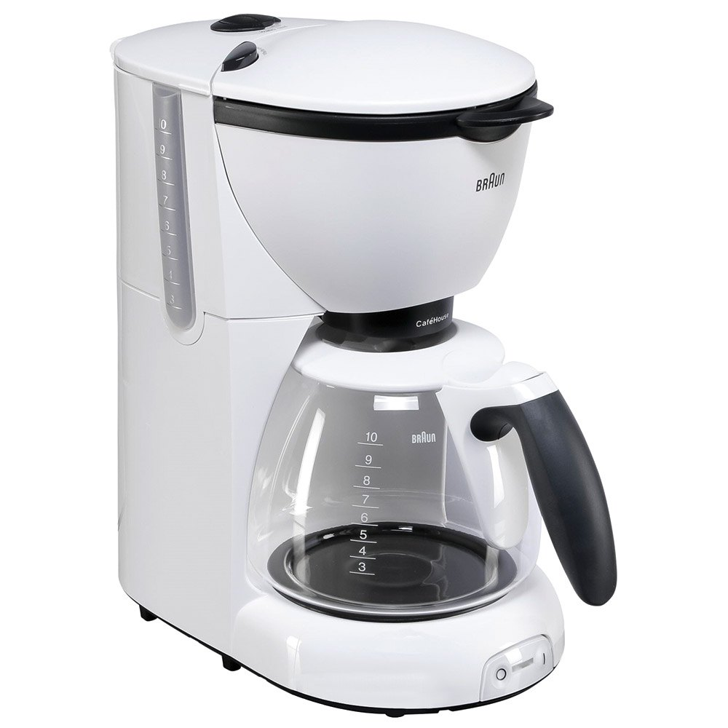
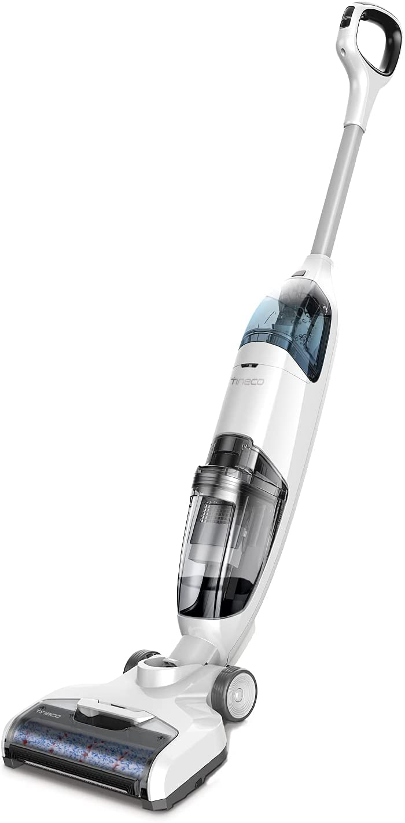
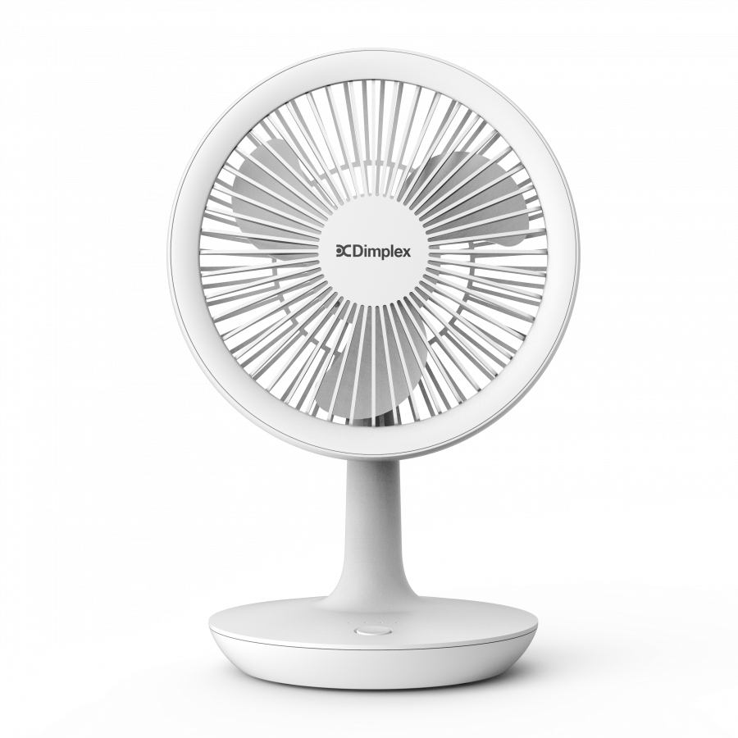
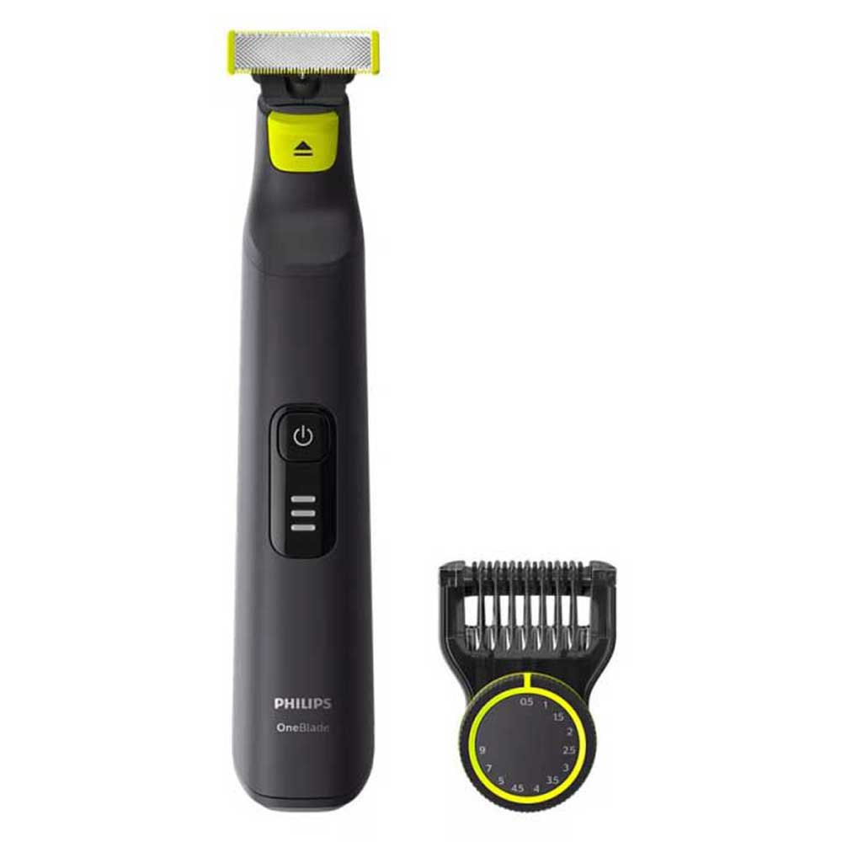
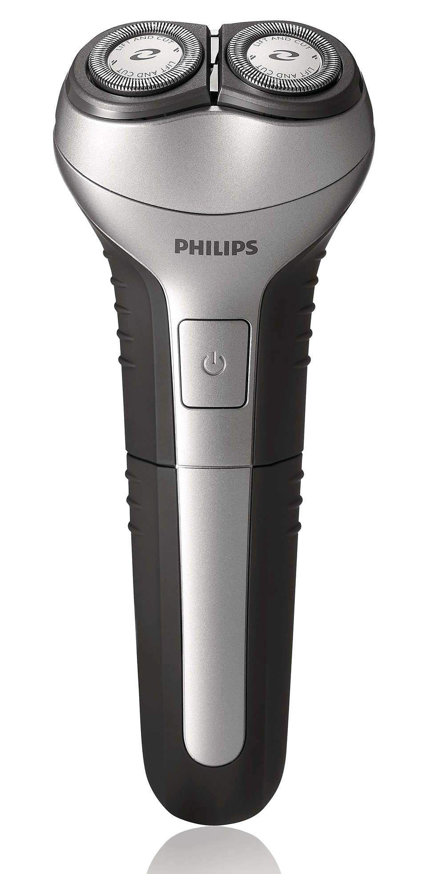
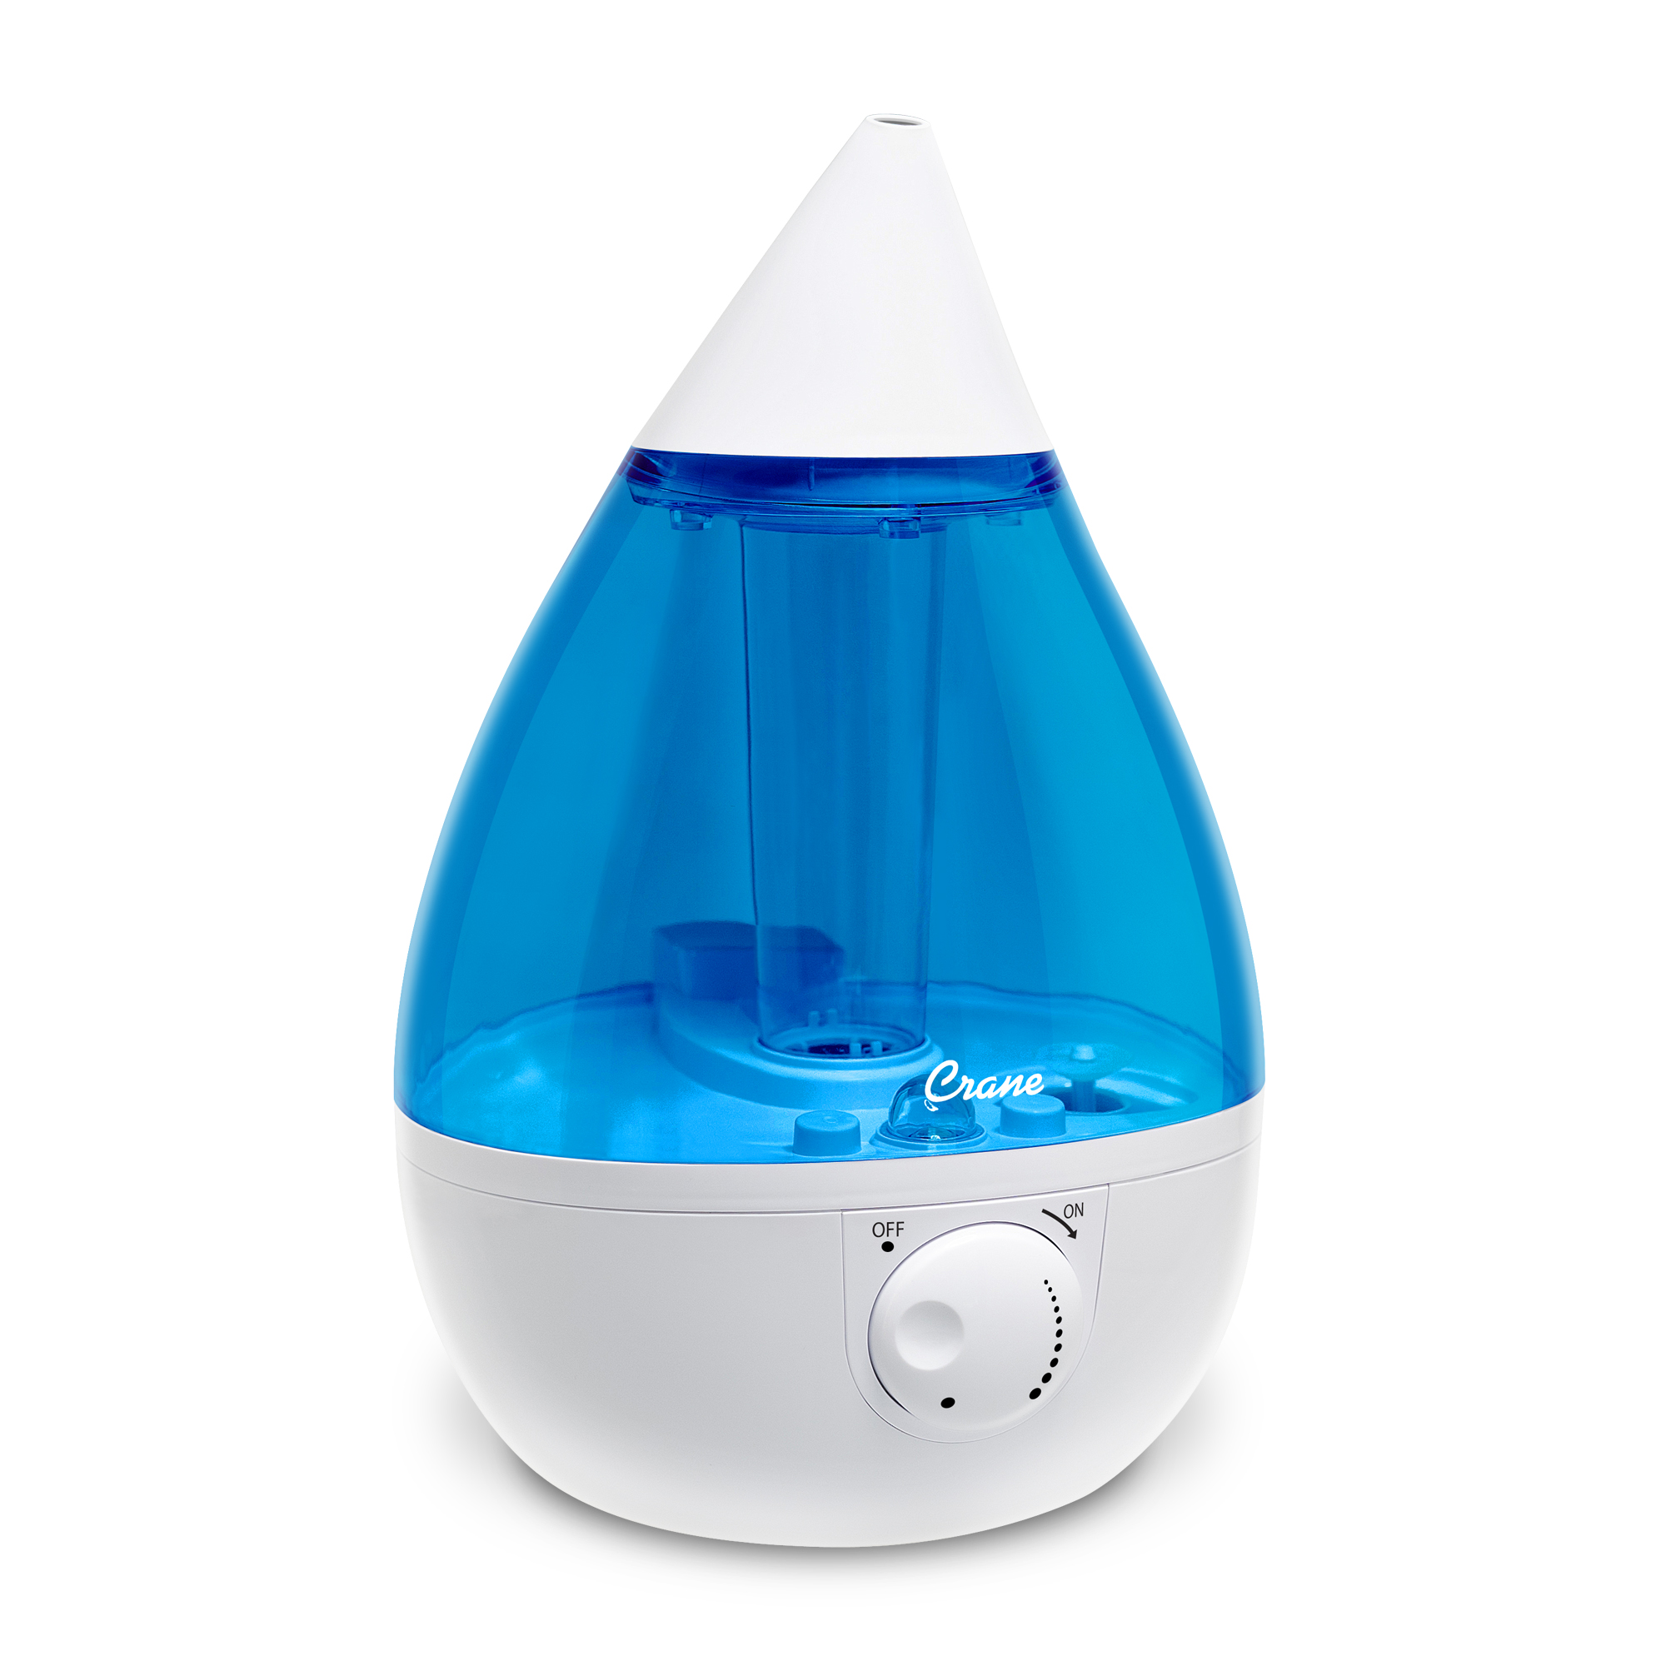
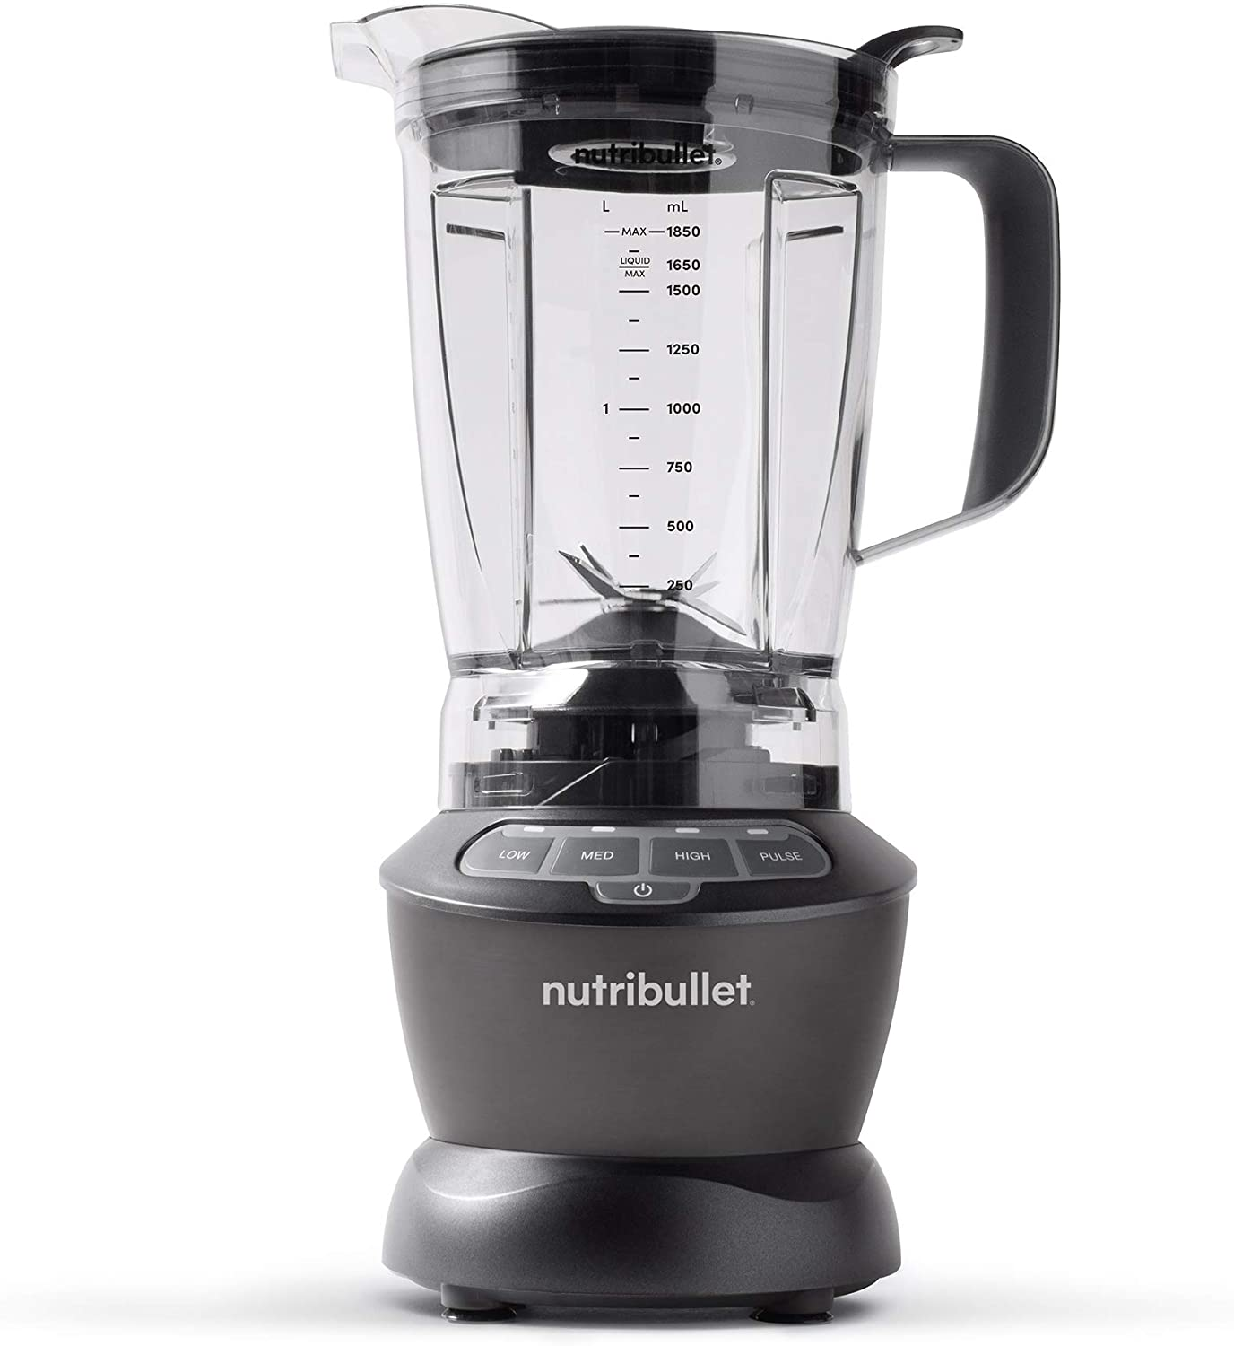
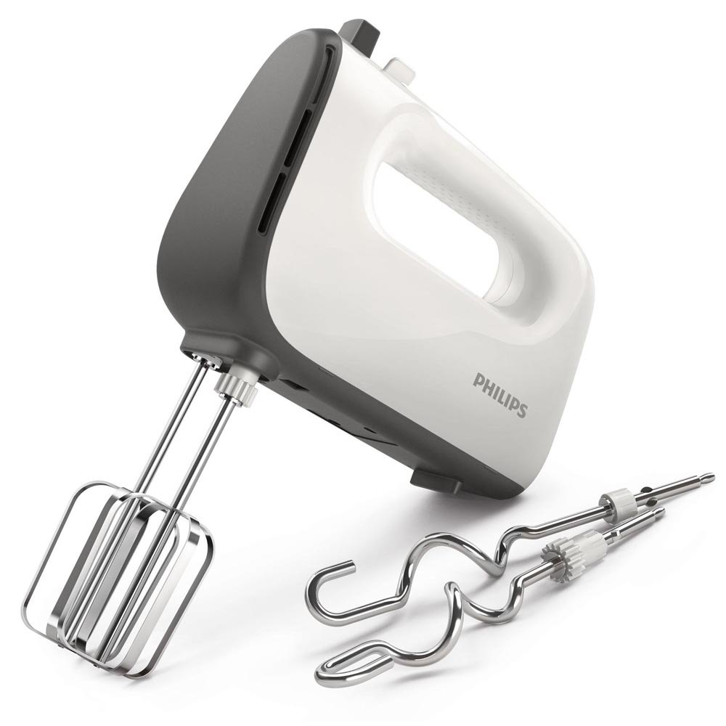
Small Appliances
Notes:
Nowadays, there are so many small appliances around us, such as tooth-brush, Hair Dryer, razor, blender, and so on..

Slide 3
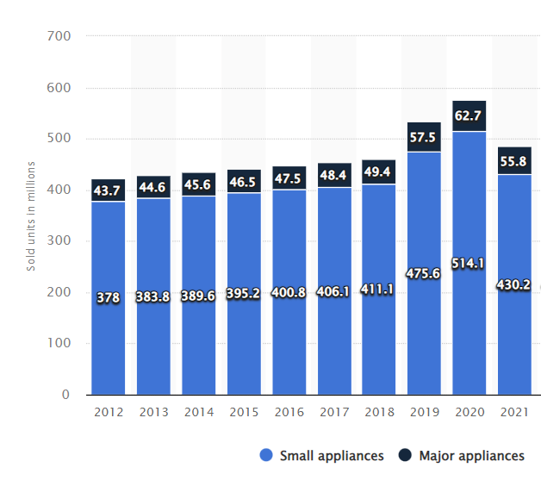
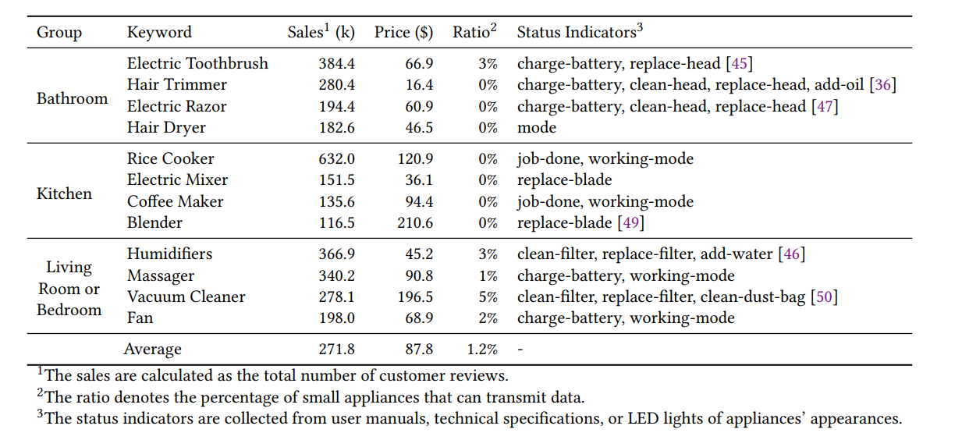
Information Island
Statista: Household appliances unit sales in the United States from 2012 to 2021
The sales, prices, ratios, and status indicators of small appliances (Amazon)
the sales volume of small appliances is 8.3x larger than that of major appliances
Small appliances contains rich status information, but only 1.2% of them are connected to the Internet
Problem: Most appliances are isolated from the Internet, impeding the further development of smart home.
Notes:
small appliances now account for a major proportion of home appliances.
However, we find that the vast majority of small appliances are not networked.
On the website Amazon, We investigate a dozen of best-selling small appliance, like toothbrush, hair dryer, coffer maker, and massager.
Surprisingly, only 1.2% of these appliances are connected to the Internet.
We then see a critical but overlooked problem, that is , Most of small appliances are isolated from the Internet. This may impedes [ɪmˈpiːdz] the further development of smart home, since most appliances are out of control or out of sensing.
A recent statistic shows that the sales of small appliances is 8 times larger than that of major appliances.
This means that,
Small appliances, account for the majority of home appliances, but they receive little attention.

Slide 4
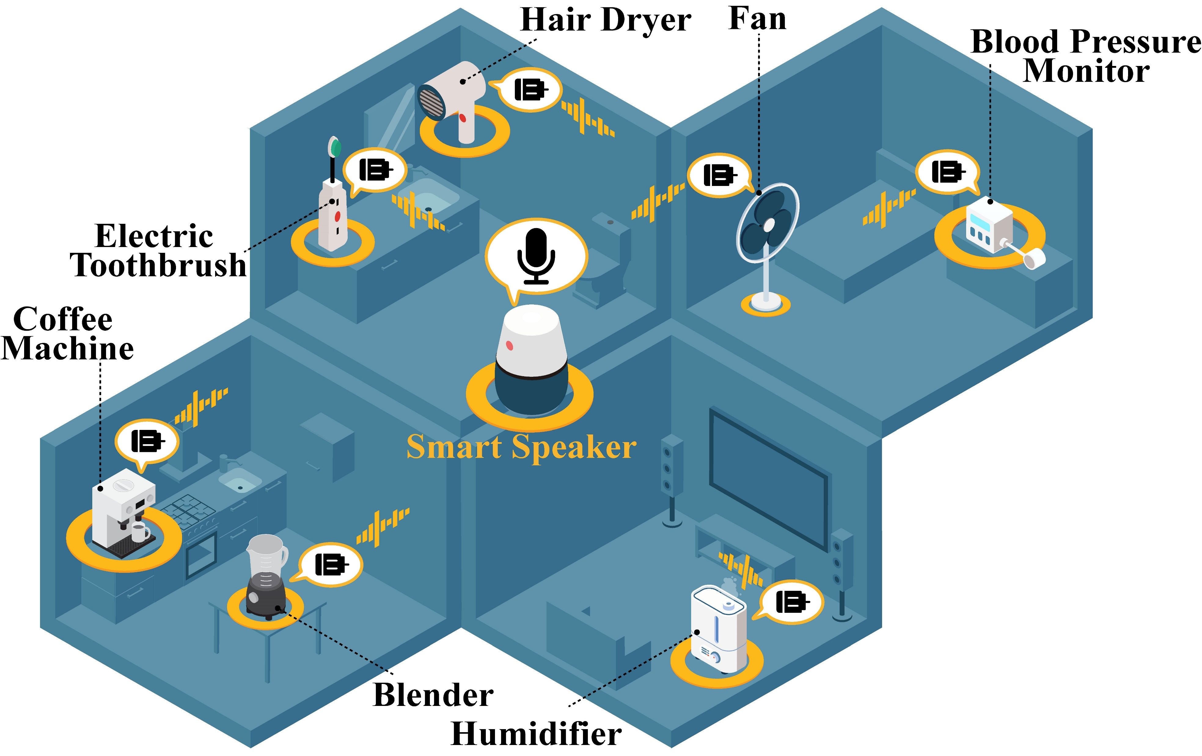

MotorBeat
Key Idea: exploit electric motors to talk to the smart speaker
Fact 1:
80% appliances contains electric motors.
wide applicability
Fact 2:
smart speakers are networked, and their microphones are “always-on”
Free gateway
Notes:
This paper presents a new communication scheme, MotorBeat, that can connect appliances to the smart speaker.
The idea is to use electric motors of small appliances, to talk to the smart speaker in the acoustic channel.
This idea is supported by two facts.
The first one, about 80 percent appliances contains electric motors. That is to say, MotorBeat can be applied to small appliances widely.
The second fact is that, smart speaker have access to the Internet, and contain “always-on” microphones.
Smart Speaker can then behaves as free gateways by receiving and relaying appliances’ acoustic messages, to Internet.
So, with the help of MotorBeat, appliances in our house can connect to the Internet via a smart speaker.

Slide 5

Applications
Start Time: 21:30
Duration: 75 sec.
Press.
DANGER !
Remind you to brush teeth
Record your daily blood pressures
Warn you about long-running devices
Notes:
We believe MotorBeat will give birth to many applications
For example, your toothbrushes can broadcast it heartbeats.
Then smart speaker can know when and how long you brush yout teetch, and remind you when forget to do so.
Similarly, smart speaker can also send you a warning message to turn off the hair dryer if it runs for an abnormal time .
More generally, smart home system can perceive more contextual information of our houses, such human activity, appliance status, and further our daily life.

Slide 6
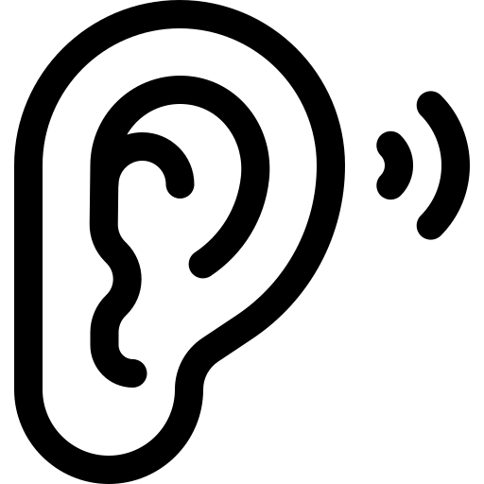
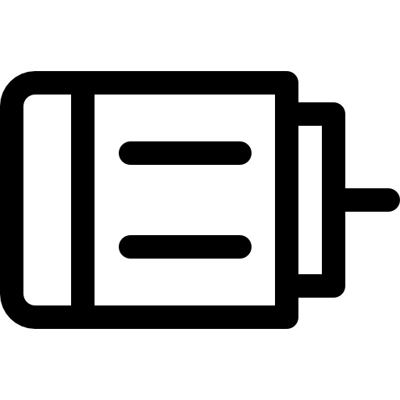
Design Goals (3C goals)
Start Time: 21:30
Duration: 75 sec.
Press.
DANGER !
Comfortable
to hear
Compatible
with multiple motor modes
Concurrent transmission
Remind you to brush teeth
Record your daily blood pressures
Warn you about long-running devices
Notes:
In practial,
MotorBeat should achieve the following three design goals:
The first goal is Comfortable.
Small appliances are designed to serve customers, not to disturb customer . So The quality of experience is Critical
This requires that the sound made by MotorBeat should be comfortable to human ears.
The second goal is Compatible.
The motors typically have multiple working modes, each mode corresponds to different operating speed.
MotorBeat should not affect the basic function of these motors.
The third goals is concurrent.
Small appliances typically have no microphone to monitor the channel.
This means CDMA scheme is infeasible for appliances to avoid communication collisions.
To tolerate the problem of collisions, MotorBeat should allow concurrent transmission and decoding.

Slide 7
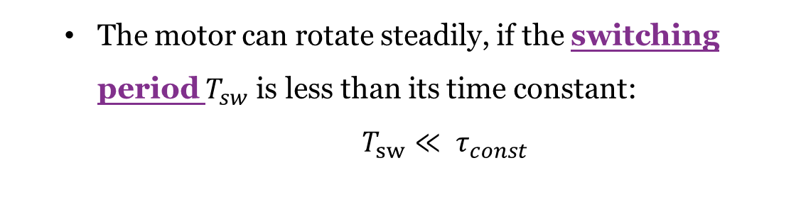
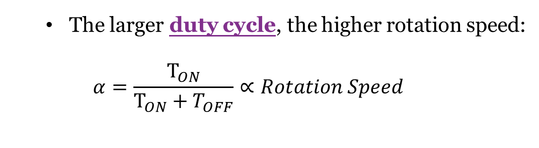
Background: Pulse-Wide Modulation
DC Motor Structure
PWM Voltage vs. Rotation Speed
The larger duty cycle, the higher rotation speed:
$$α=\frac{T_{ON}}{T_{ON}+T_{OFF}}∝Rotation Speed$$
The motor can rotate steadily, if the switching period $T_{sw}$ is less than its time constant:
$$T_{sw}≪ τ_{const}$$
Time constant is defined as the time the motor takes to reach its 63% (≈ 1 − 1/𝑒) maximum speed.
Notes:
Let’s have a quick recap of how a DC motor works
Typically, Pulse Width modulation, PWM, is used to drive the DC motor.
PWM voltage is a periodic signal with two states, ON and OFF.
PWM has two key parameters: duty cycle and switching period.
Duty cycle is defined by this equation. As a rule of thumb, the larger duty cycle, the higher rotation speed.
Switching periods denotes the time duration of pulse.
//Let’s have a quick recap of how a DC motor works
//DC motors consists of two main components, stator and rotor.
//The stators contains magnets on the side, the rotor has coils.
//When the DC motor is powered, the rotor will generate a electromagnet, and will be attracted or repelled by the magnets of the stator.
//The brushed are used to switch the polarity of the electromagnet, so that the rotor can keep rotating in the same direction.

Slide 8


Acoustic Characteristics of DC Motors
The motors generate two types of acoustic signals during rotation:
Mechanism-Induced (MI) Sound
Electromagnetism-Induced (EI) Sound
The sources of the MI signal:
The misalignment between the rotor’s inertia axis and its geometric axis.
The friction between the brushes and the rotor.
The static and dynamic magnetic fields will make the stator and the rotor attract or repel each other.
This will further cause the slight deformation of the motor.
Acoustic Side-Channel: The EI sound can be modulated by the voltage
Notes:
The rotating motors generate two types of acoustic signals.
The first one is mechanism-induced (MI) Sound, We call it MI sound.
When the rotor’s inertia axis and its geometric axis are aligned, the MI sound will be generated.
Also, the friction from the brushed will also generate the MI sound.
The second type is Electromagnetism [ɪˌlektroʊˈmæɡnətɪzəm]-Induced (EI) Sound, We call it EI sound.
At a high level, the attractions or repels of magnetic fields in the motor will cause the slight deformation of the motors.
This deformation will further make sound, we will explain this later.
Our observation is that using the voltage to modulate the EI sound can generate a predictable acoustic sounds.
In other words, the EI sound can used as acoustic side-channel for appliance communications.

Slide 9
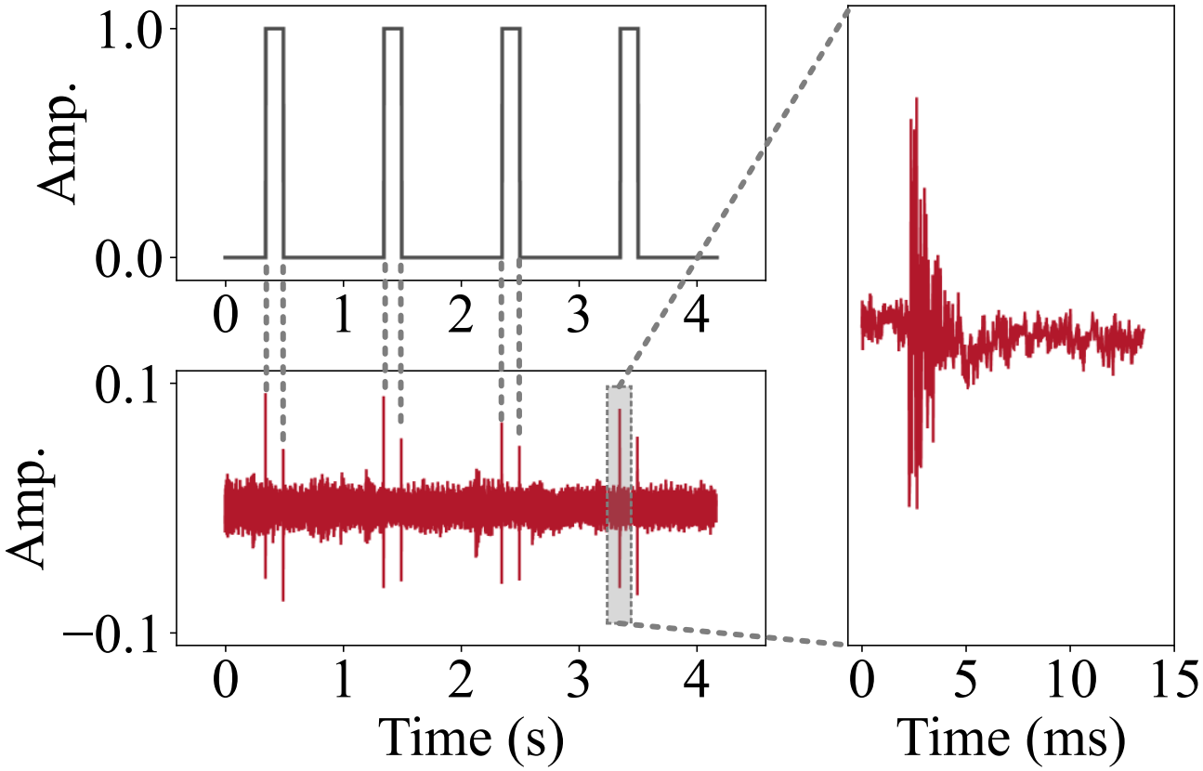


Demystify the EI sound
The applied voltage
The EI sound
Both switching ON and OFF the motors will make certain sounds:
As the motor is switched ON, the electromagnetic force will be generated. The sudden appearance of this force behaves like a “physical knock” onto the motor, thus making the sound.
As the motor is switched OFF, the electromagnetic force will disappear suddenly, which also acts as a “physical knock”.
Take-away: Switch ON/OFF the motor ≈ Knock the motor
Notes:
OK, the EI sound might be a little complicate to understand.
So, I want to give more explanations,
Here, the top picture illustrates the voltage and the corresponding EI sound.
We can find that, both switching ON or OFF the motors will make certain sounds.
At the moment when the motor is switched on, the certain electromagnetic force will be generated.
The sudden appearance of this force behaves like a “physical knock” onto the motor,.
thus making the sound.
Similarly, when the motor is switched off, the force will disappear suddenly, thus also acts as a “physical knock”

Slide 10
Question
The applied voltage
The EI sound
Question: How to modulate the voltage to transmit messages via the EI sound, while achieving the 3C goals
Both switching ON and OFF the motors will make certain sounds:
As the motor is switched ON, the electromagnetic force will be generated. The sudden appearance of this force behaves like a “physical knock” onto the motor, thus making the sound.
As the motor is switched OFF, the electromagnetic force will disappear suddenly, which also acts as a “physical knock”.
Take-away: Switch ON/OFF the motor ≈ Knock the motor (slightly)
Notes:
So, our final question
How to modulate the voltage to transmit messages via the EI sound, while achieving the 3C design goals

Slide 11
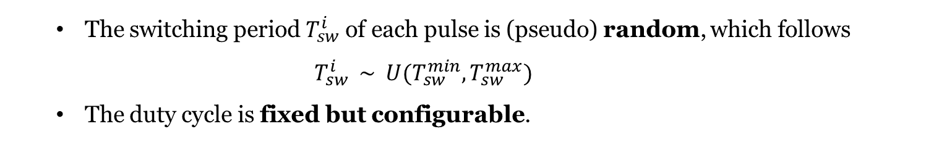
Variable Pulse Width Modulation
Variable Pulse Width Modulation, V-PWM
Key Design: randomizing the switching periods , while fixing the duty cycle
The switching period $T_{sw}^{i}$ of each pulse is (pseudo) random, which follows
$$T_{sw}^{i} \sim U(T_{sw}^{min},T_{sw}^{max})$$
The duty cycle is fixed but configurable.
Notes:
Our key design is to introduce a novel modulation scheme, Variable Pulse Width Modulation, V-PWM.
The design of V-PWM is simple.
We randomize the switching periods, while fixing the duty cycle.
More specifically, pulses in V-PWM are different.
They have random switching periods, following uniform random distribution.
But, these pulse have the same duty cycle.

Slide 12
Variable Pulse Width Modulation
Variable Pulse Width Modulation, V-PWM
Comfortable
Compatible
Concurrent
Random frequency
No harmonics.
Online configure duty cycle
Not impeding transmission
Similar to CDMA.
Each appliance has an unique V-PRWM symbol.
Orthogonal to each other
Notes:
Let us further explain why V-PWM can achieve our 3C goals.
Firstly,
Because the switching periods are random, so the fundamental frequency of the sound are also radom.
By doing so, the harmonics of the acoustic signals, which sound uncomfortable, are significantly reduced
So, Comfortable, Check!
Furthermore ,The duty cycle of the voltage can be configured online without impeding the transmission, thus supporting multiple working modes of motors.
So, Compatible Check!
Last, we assign each appliance with a unique V-PWM symbol.
All appliances symbols are orthogonal to each other. Similar to Code-Division Multiple Access (CDMA), multiple appliances are
allowed to transmit concurrently. The MotorBeat receiver is able to separately detect and decode messages of
these appliances
So, Concurrent Check!

Slide 13
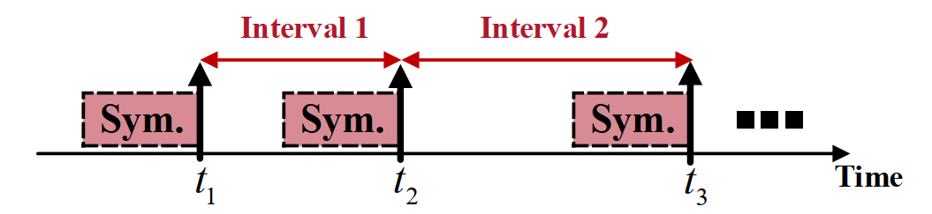
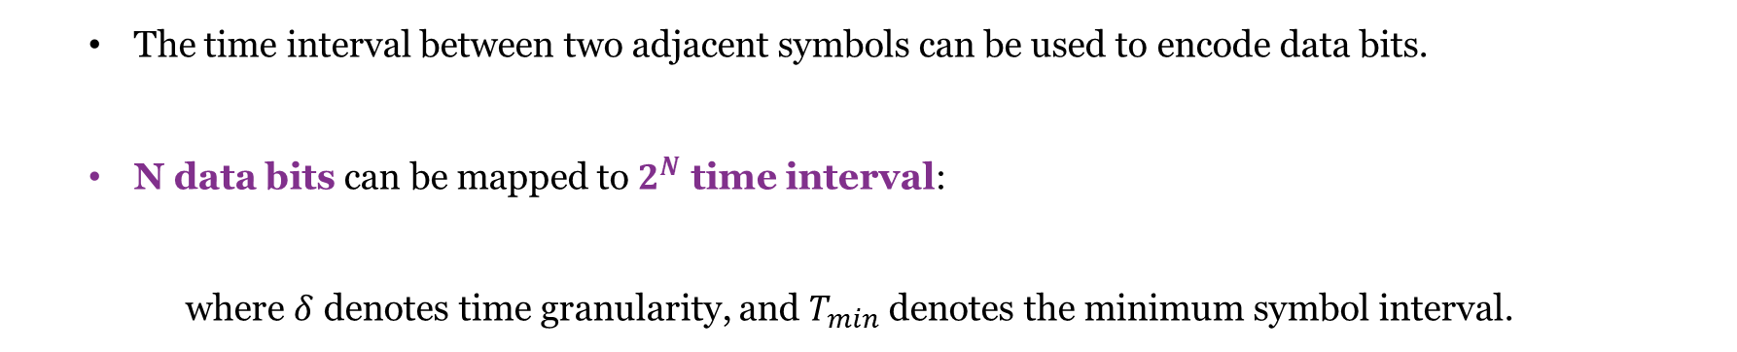
Transmit Data Bits
Illustration of bit encoding
The time interval between two adjacent symbols can be used to encode data bits.
N data bits can be mapped to $2^{N}$ time interval:
where $δ$ denotes time granularity, and $T_{min}$ denotes the minimum symbol interval.
$$T_{interval}=Kδ+T_{min}, K=[0,1,…,2^{N−1}]$$
Notes:
in addition to broadcast appliances heartbeats, MotorBeat can also be used to transmit data bits.
The idea is that
We can encode data bits into the time interval of two adjacent symbols.
For example, N data bits can be mapped to 2^N time intervals.
Then, We can dedicatedly choose the transmission timing of two symbols to encode these data bits.

Slide 14
Receiver Design
Illustration of the receiver design
The matched filter is used to detect V-PWM symbols.
taking the known V-PWM symbols as templates
correlating templates with the received audio.
If a high correlation peaks is observed, then a V-PWN is detected.
The receiver can output two types of information
Heartbeat: If one V-PWM symbol is detected, we then know the corresponding appliance is ON. <Appliance ID, timestamp, ON>
Data bits: the receiver extracts the time intervals from the timestamps of heartbeats, and decode data bits from these intervals. <Appliance ID, timestamp, Data Bits>
Notes:
For the

Slide 15
Implementation
Toothbrush
(TB)
Fan
Blood Pressure Monitor（BPM）
MotorBeat Prototype
Appliances used for evaluation
Notes:
This is the prototype of MotorBeat.
We evaluate MotorBeat on three different appliances, TB, fan, B [blʌd] PM

Slide 16
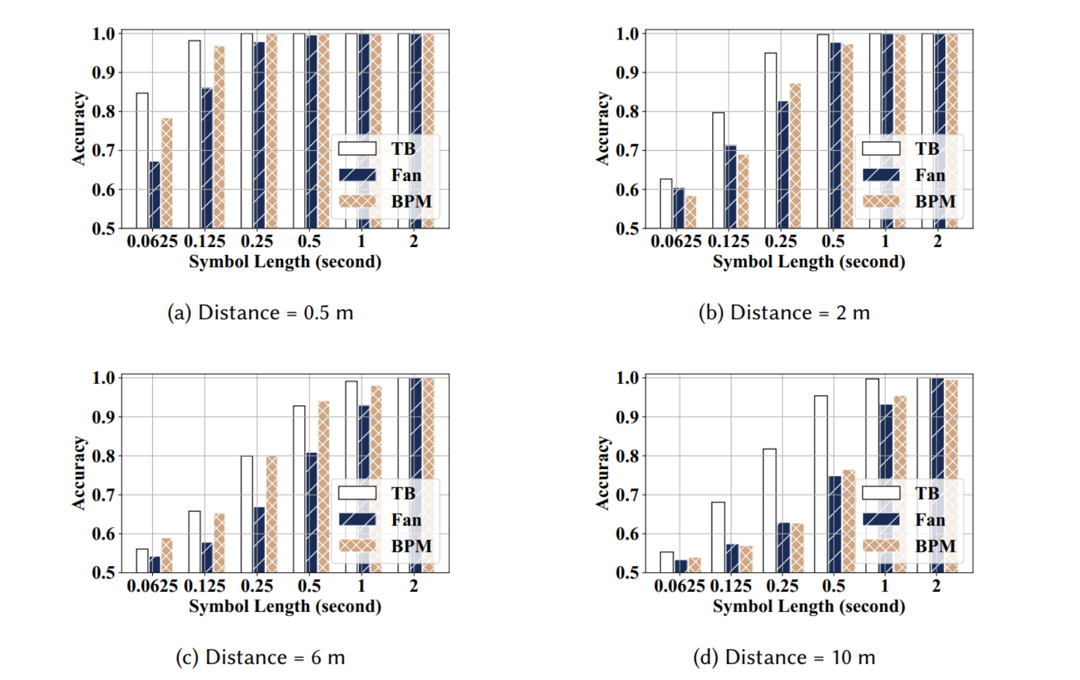
Heartbeat Detection
Distance 0.5m
Distance 2m
Distance 6m
Distance 10m
Heartbeat detection accuracy vs. symbol length in different distances
The detection accuracy increases as the symbol length increases.
The performance also varies across appliances. the fan performs worst since its rotating blades introduce the most noise.
The communication range can be up to 10 m.
Notes:
In general,
The evaluation shows that The communication range of MotorBeat can be up to 10 m.

Slide 17
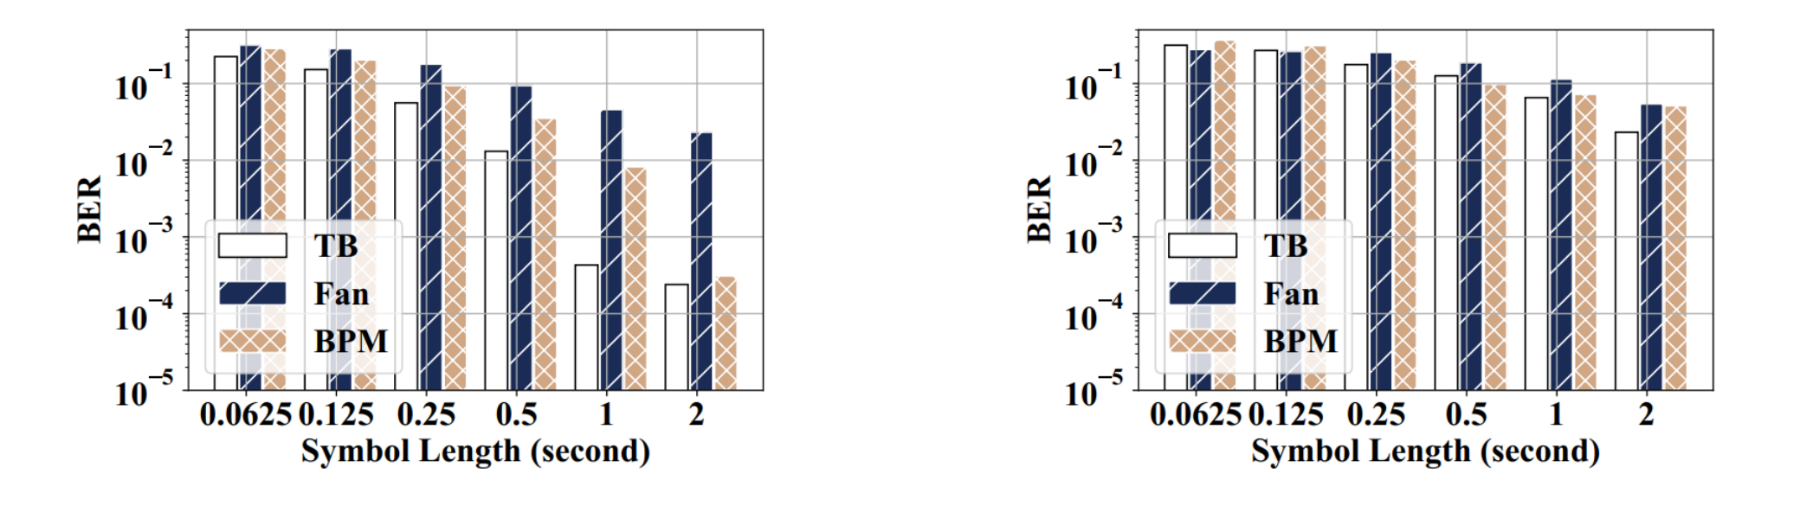
Bit Error Rate
Distance 2m
Distance 10m
BER vs. time resolution at different distances
As the symbol length increases, the BER increases.
However, the throughput will decrease as the symbol length increases
The throughputs are 195.8 bps, 102.6 bps, 53.7 bps, 28.1 bps, 14.6 bps, and 7.6 bps when the symbol length is increased from 0.0625s to 2s.
Notes:
Meanwhile,
Depending on the symbol length, The throughputs we can achieve are from 8 bps to 200 bps

Slide 18
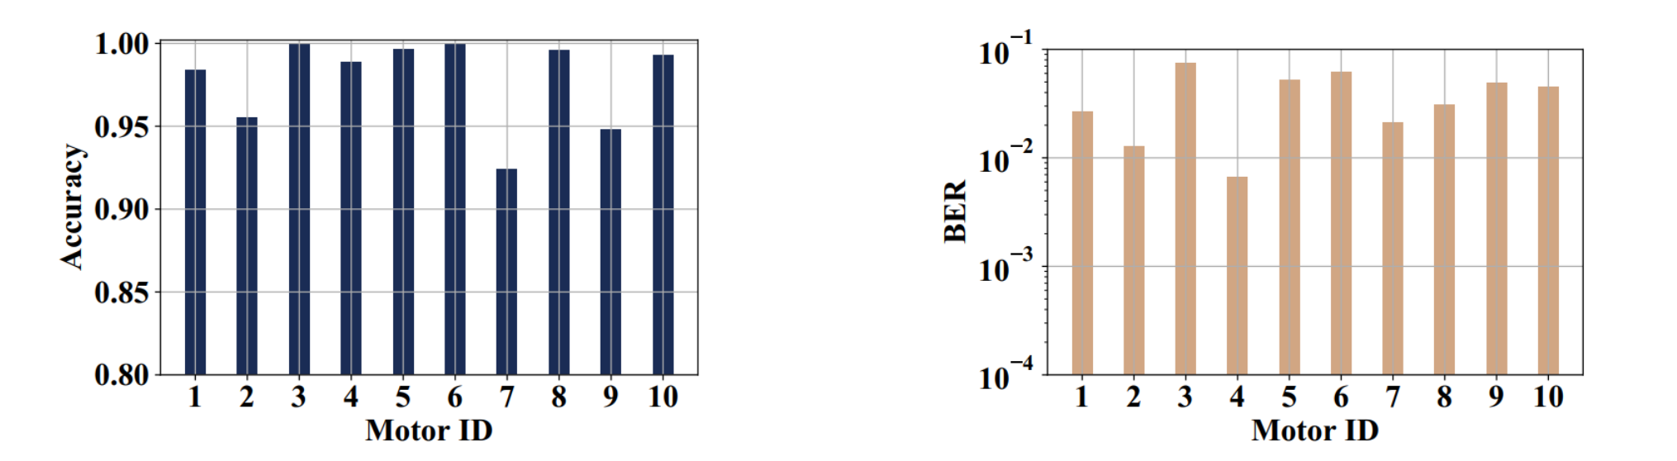
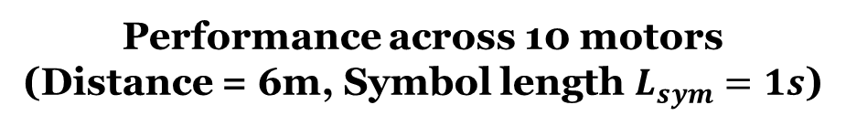
More Motors
Heartbeat Detection
BER
10 different motors
Performance across 10 motors
(Distance = 6m, Symbol length $L_{sym}=1s$)
MotorBeat can be applied to various motors.
The side-channel does exist in various motors.
Notes:
We also evaluate MotorBeat on 10 different motors, as shown in the left pictures.
The results show that MotorBeat can be applied to all these motors.
This actually indicates that the side-channel we find does exist in various motors.
We believe this side-channel can be used for not only acoustic communication, as we do, but also other sensing tasks.
That is all, thank you

